Slide 1
Discussion Topic: Q Gate
Date- 13/07/2018

Slide 2
Contents
What is Critical ?
What is Capable ?
Critical V/s Capable
Inspection Std.
Q Gate Concept
Q & A Session

Slide 3
1. Critical

Slide 4
1. Critical

Slide 5
1. Critical

Slide 6
1. Critical

Slide 7
1. Critical

Slide 8
Severity Ranking

Slide 9
Characteristics
Critical Characteristics: <C> : Deviation beyond specified tolerances could jeopardize persons respectively human life or affect compliance with governmental regulations
Significant Characteristics: <M> : deviation beyond specified tolerances could jeopardize products or processes or reduce lifetime or utility of components, products, systems or applications
High Impact Characteristics: <R> : A feature identified on component drawings and specifications, whose non-conformance would potentially disturb its final customer assembly process. All parameters on component drawings and specifications, which remain as finished once mounted on products, are in general considered as High Impact Characteristics. Those specifications which are finally identified as High Impact Characteristics are then highlighted on the component drawings and specifications.
Comment: Critical and Significant Characteristics should be numbered (i.e. SC1, SC2 ... SCn) to allow a better traceability of the parameters.

Slide 10
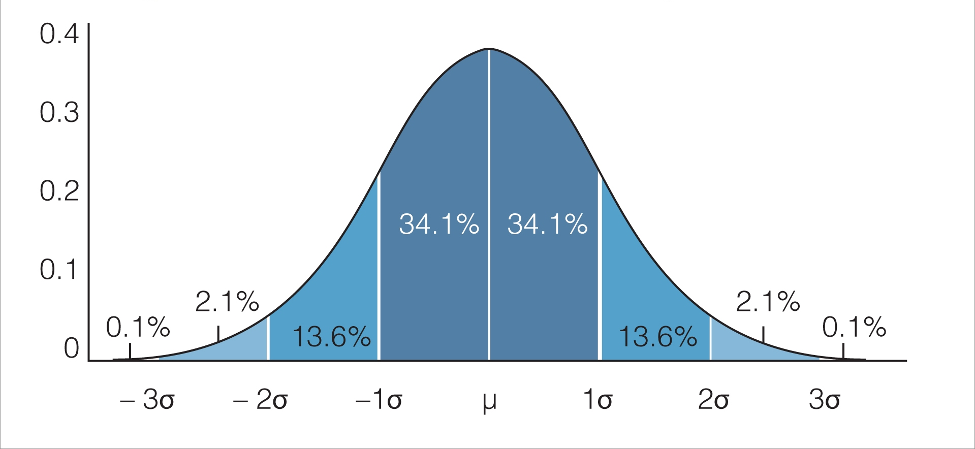
2. Capable
10
20
30

Slide 11
2. Capable

Slide 12
2. Capable

Slide 13
2. Capable

Slide 14
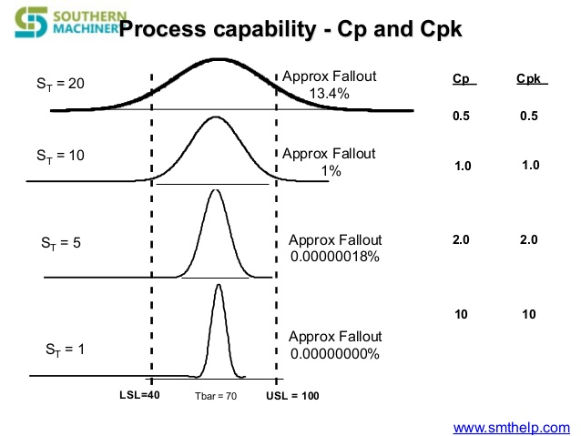
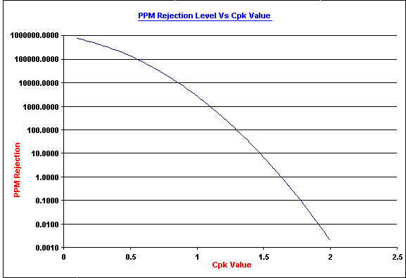
2. Capable

Slide 15
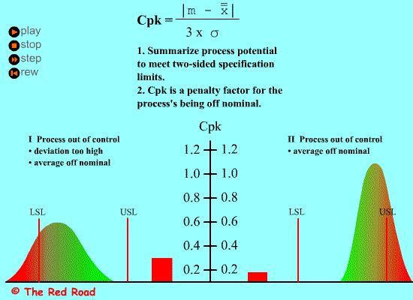
2. Capable

Slide 16
Variation ?

Slide 17
3. Critical V/s Capable
Critical + Non Capable
Critical + Capable
Critical
Non Critical + Non Capable
Non Critical + Capable
Capable

Slide 18
4. Inspection Std

Slide 19
4. Inspection Std

Slide 20
4. Inspection Std

Slide 21
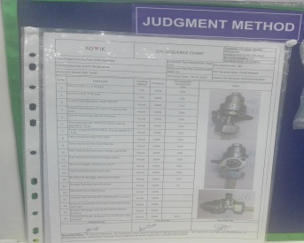
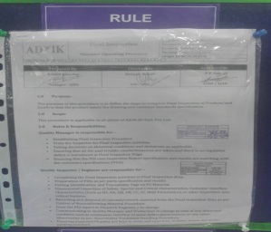
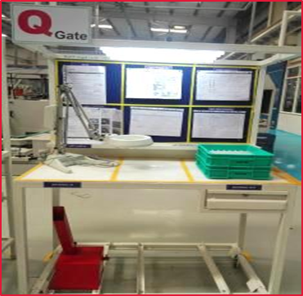
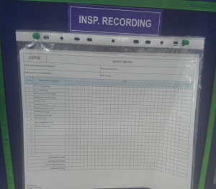
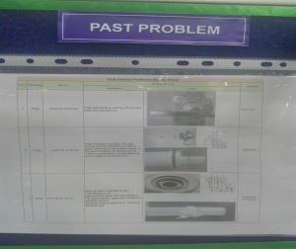
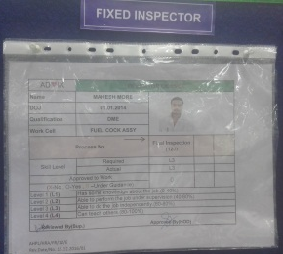
Q Gate @ AHPL -15 for Manual Fuel cock
Illumination Lux Level Min 700
Q-Gate Identification Board
Limit Samples
Inspection Eye Sequence
4
1
Q-Gate Rule
1
2
3
5
Defect Matrix
2
Past Problems
4
5
6
Magnifying Glass
Inspection Recording Defect Monitoring Sheet
3
Fixed Inspection
( As Per Skill Chart)
6
Red Bin

Slide 22
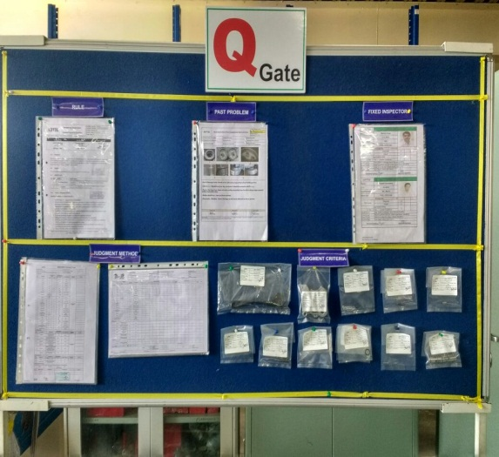
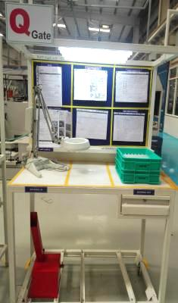
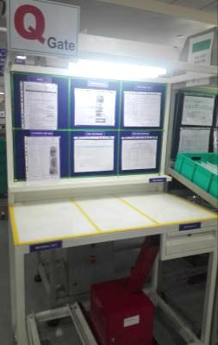
Q Gate @ AHPL -15 for Manual Fuel cock
Location | Inwarding Q Gate | Machine Shop Q Gate | Assembly Q Gate
Q-Gate Photo
Past problems Check points | Body :- Forging wrinkles in the outer surface. emboss casting-defect. scratch, dent in seal side of, screen o ring bigger off-set in mold, for its core shifting between casting . depth dimension from upper end to ON pipe insertion seat . packing area step & Burr . Dent at the top of o ring contact face . Lever :- Burr in mold matching portion of X ring groove inner portion . burr in the depth of fuel passage groove, Bowl :- Forging wrinkle at contact surface with O ring Plate-Stamping coming-off from the plate. Fuel Level Pipe :-Chamfer at the ends. | Body:- The machining burr from fuel joint hole. depth dimension from upper end to ON pipe insertion seat . screw machining depth emboss casting-defect. Interference of filter pillar with Bowl inner side . Chamfer at pipe fitment depth. Bowl :- The screw thread misalignment in mold matching portion. dent and damage at bowl threading area. Lever- burr in the depth of fuel passage. | Assembly :- Body & Plate- gap between Plate & body surface >0.2mm. Body ,Fuel level pipe & Filter :- If screen filter is pulled, ON pipe should not comes off. confirmation height of 65 max. Visual Inspection :- Manufacturers mark Traceability mark No Burr, flashes, rust. No sharp edges. No dent & damages. No foreign particles. All child part present.

Slide 23
Q-A Session

